Slide 1
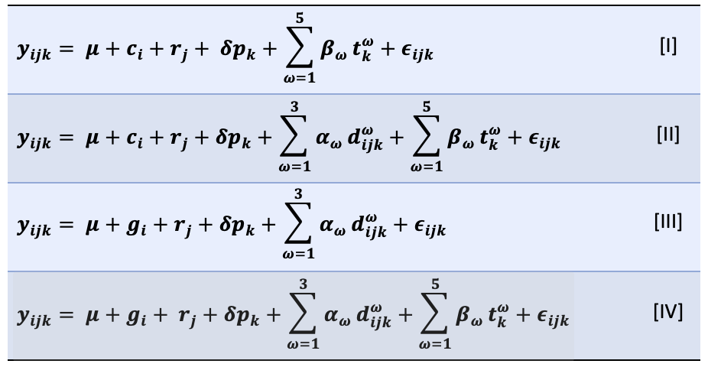
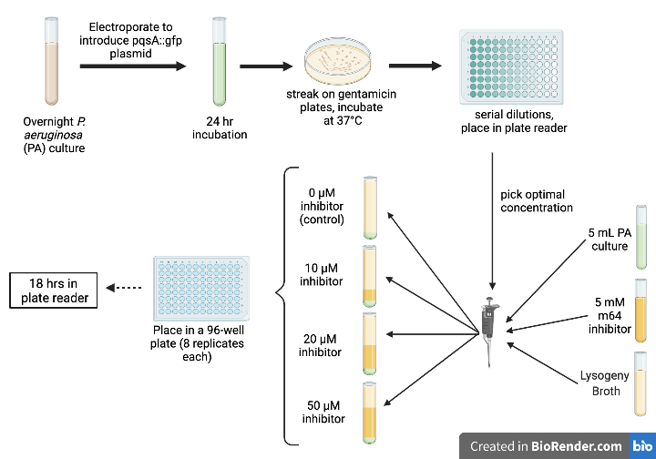
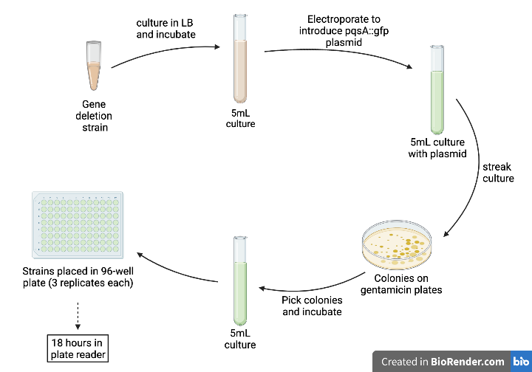
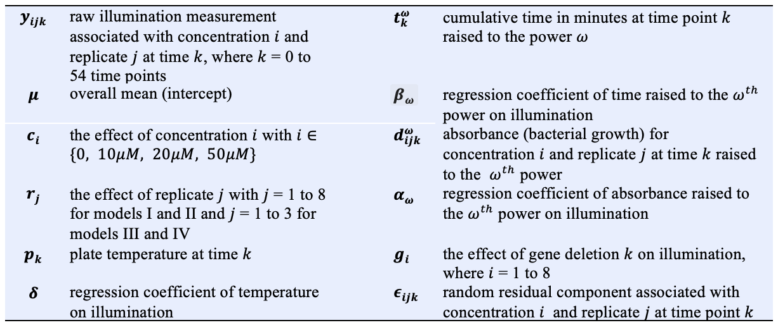
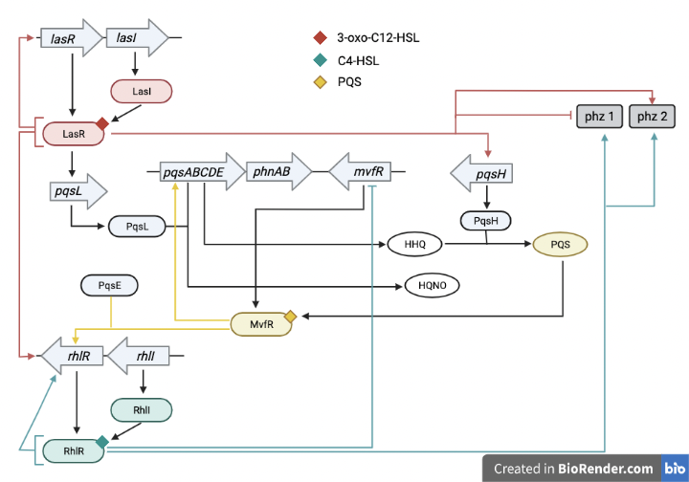
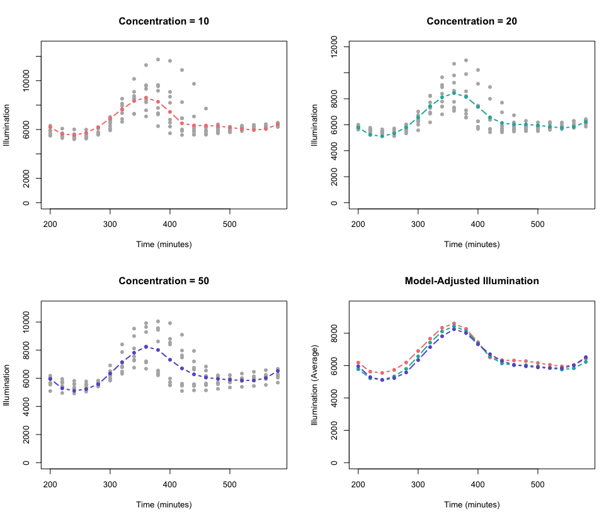
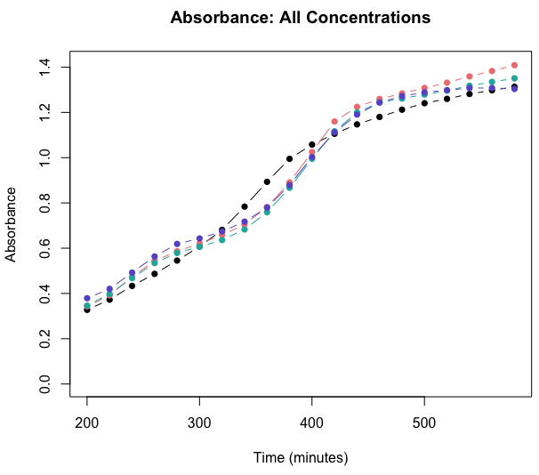



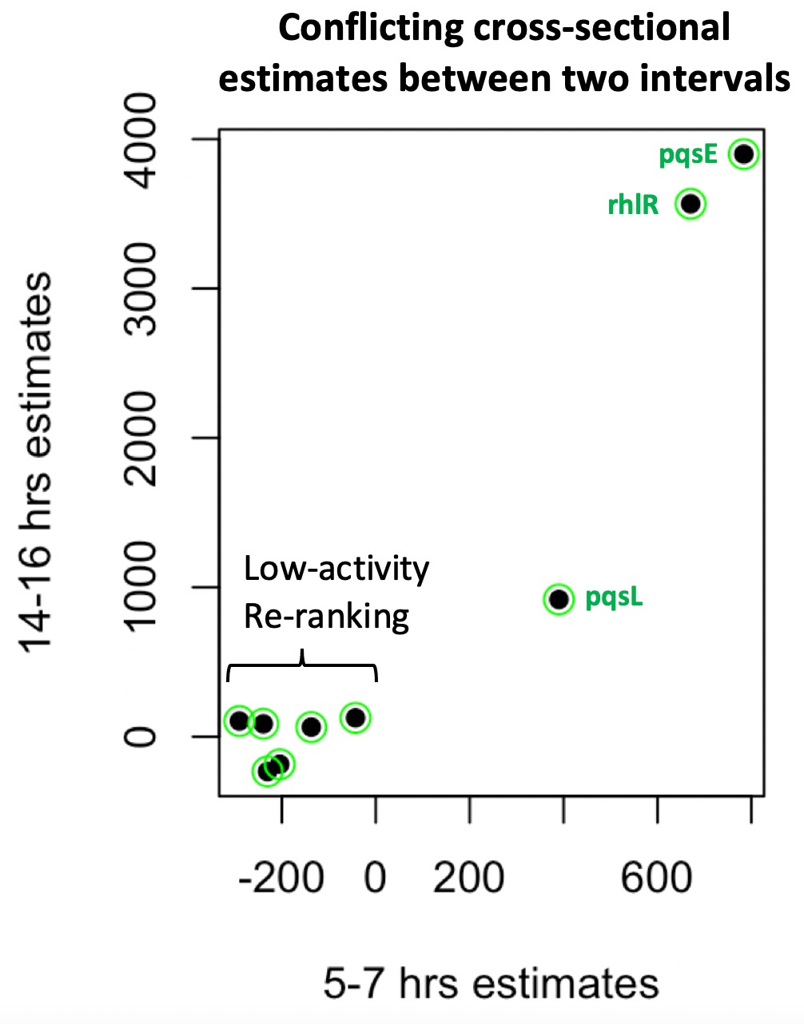


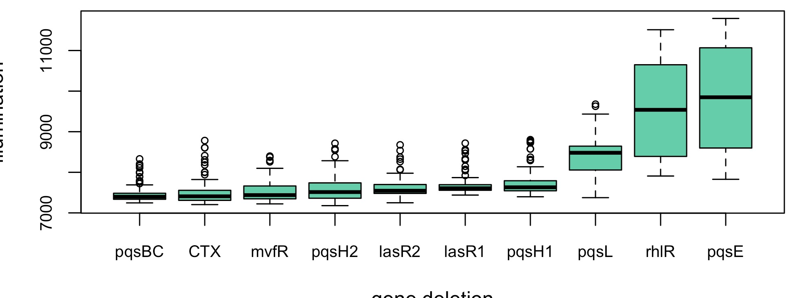
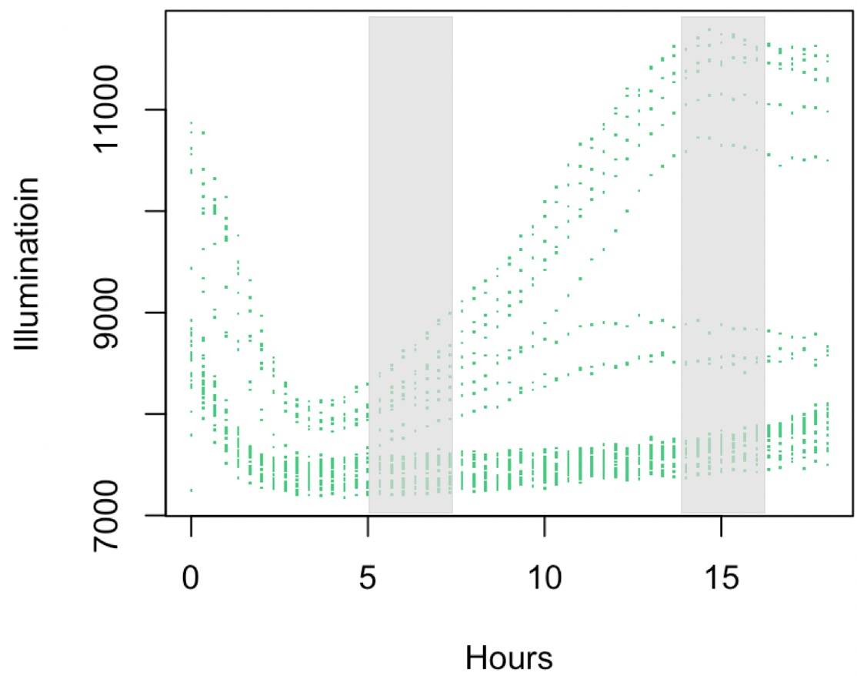
Modeling Quorum Sensing Cycles in P. aeruginosa using Longitudinal Approaches by Measuring Gene Expression
Maryam Abdel-Azim
BACKGROUND
METHODS
MODELS USED
Quorum sensing (QS) is the process of cell-to-cell communication for the purpose of acquiring information about the cellular density in the environment.
This process enables bacteria to behave in a synchronous manner to regulate gene expression, allowing for a magnified effect.
Inhibition Strains (Validation)
Introduce plasmid with GFP (green fluorescent protein) tagged to pqsA
pqsA plays a significant role in QS
4 different concentrations of M64 were used to interrupt QS
M64 inhibits MvfR, and thus interrupts the QS cycle
8 replicates were used for each concentration of M64 inhibitor
All replicates (in a 96-well plate) were placed in a plate reader for 18 hours, collecting fluorescence and absorbance (OD) data for each well every 20 minutes
Gene Deletion Strains (Implementation)
8 different gene deletion strains of P. aeruginosa with 3 replicates each were studied
pqsA-tagged GFP plasmid were introduced to bacteria and the culture was grown and streaked on gentamicin plates
This ensures that all live colonies have the plasmid
Bacteria were grown in a liquid culture until it reached an absorbance value of 1
20µL of bacteria were then pipetted into each well with 230µL of LB. The 96-well plate was placed in a plate reader
Data was collected for 18 hours every 20 minutes
Statistical models used for validation and implementation experiments.
Low Cell Density
Pseudomonas aeruginosa is a gram-negative, opportunistic pathogen involved in many diseases.
These diseases include cystic fibrosis, enophthalmos, and pneumonia.
Chemical Signal
Covariates included: concentration, gene deletion, replicate, bacterial growth (OD), temperature, and time.
Pseudomonas aeruginosa is able to form biofilms and produce pyocyanin, which work in protecting the bacteria against environmental stress.
Biofilm and pyocyanin production are regulated by quorum sensing.
Green fluorescent proteins (GFP) can be used to track the expression of genes by introducing a constructed plasmid to the bacteria. Transformed bacteria will fluoresce and this can be measured by devices such as the plate reader.
In this experiment, GFP was tagged to the gene pqsA since it is known to play a crucial role in QS.
High activity of this gene (as shown through fluorescence by GFP) meant high QS activity.
Quorum sensing pathway proposed for P. aeruginosa
CONCLUSIONS
RESULTS
A Longitudinal Quorum Sensing Modeling approach (LQSM) was developed and validated using multiple concentrations of M64, a QS inhibitor.
The approach was successfully implemented to bacterial strains with a variety of gene deletions that impact QS. Gene deletions were prioritized according to their QS activity which shows the importance of each gene to the QS cycle in P. aeruginosa.
It is shown that raw fluorescence data, even though collected almost continuously overtime, may still give wrong conclusions if it is not statistically adjusted for important covariates such as bacterial growth.
It is recommended that LQSM is to be integrated in the software of medical and laboratory devices that collect data through time.
The cross-sectional approach gives conflicting conclusions about the importance of gene deletions in the quorum sensing pathway
Figure 2. Comparing the concentration estimates of 2 models, Models I and II, one that does not adjust for OD (Model I: red) and another that adjusts for all confounders (Model II: black).
Figure 3. Illumination (raw fluorescence) against time for concentrations 10, 20, and 50µM between time intervals of 200 and 600 minutes. Absorbance-adjusted fluorescence is shown in colored curves. Adjusted data was obtained from Model II.
Concentration = 10 µM
Concentration = 20 µM
Absorbance: All Concentrations
Concentration = 50 µM
Model-adjusted Illumination
In the pathway, different colors represent the 3 main quorum sensing systems in the pathway: Las, Rhl, Mvf/Pqs
To inhibit quorum sensing during the validation phase of the project, M64 was used
M64 suppresses the gene mvfR in the pathway above
FUTURE RESEARCH
Suppress the expression of QS in P. aeruginosa (and other bacteria like S. aureus) by targeting autoinducers instead of genes, to curb virulent properties.
The LQSM approach will be used to compare the effectiveness of targeting autoinducers vs. genes.
Signal molecule-sequestering polymers (SSPs) will be used to target autoinducers.
P. aeruginosa is an extremely virulent organism with strong capabilities to mutate and gain resistance against anti-bacterial drugs. Attenuating the evolutionary power of P. aeruginosa against drugs using anti-QS compounds will be studied as a combination treatment to sustain the effectiveness of drugs and prevent bacteria from gaining resistance.
LQSM will be a precise tool to evaluate and compare anti-QS treatments.
Full model correctly estimated true QS activity, whereas ignoring OD overestimated QS activity.
PURPOSE
Figure 4. Raw fluorescence for gene deletion strains through time.
Figure 5. Absorbance-adjusted fluorescence for gene deletion strains. Factors such as absorbance, temperature, and type of gene deletion strain were accounted for in each curve (Model IV).
1) In this study, I accurately identified the role and prioritize critical genes to QS. This allows for those genes to be used as drug targets, preventing P. aeruginosa from gaining antibiotic resistance.
2) I developed a robust statistical technique to accurately measure QS activities by observing the entire cycle while adjusting for interfering confounders. The method is useful for integration with medical devices software.
HYPOTHESIS
TOOLS USED
The quantification of QS can be made significantly more precise and accurate using longitudinal statistical modeling, as opposed to raw, unprocessed fluorescence data recorded at one time point.
Wet Lab
Plate reader Infinite 200 PRO
Centrifuge
MicroPulser system
Spectrophotometer
Vortex mixer
Computational
IMPLEMENTATION DATA
Genes ranked based on QS activity when they are deleted. pqsH gene deletion strain was ranked lowest, meaning weaker QS activity. pqsH controls the production of PQS, which serves as an autoinducer that binds to MvfR. This gene deletion strain had a greater impact on QS because it disrupts an upstream process that affects the activation of multiple other genes.
SELECTED REFERENCES
Figure 1. Boxplots of raw fluorescence data ordered lowest to highest.
Hoffman, Lucas R., et al. “Pseudomonas Aeruginosa Lasr Mutants Are Associated with Cystic Fibrosis Lung Disease Progression.” Journal of Cystic Fibrosis, vol. 8, no. 1, 2009, pp. 66–70.
Mould, D. L., Botelho, N. J., & Hogan, D. A. (2020). Intraspecies signaling between common variants of pseudomonas aeruginosa increases production of quorum-sensing-controlled virulence factors. MBio, 11(4).
Starkey, Melissa, et al. “Identification of Anti-Virulence Compounds That Disrupt Quorum-Sensing Regulated Acute and Persistent Pathogenicity.” PLoS Pathogens, vol. 10, no. 8, 2014.
Guendouze, Assia et al. “Effect of Quorum Quenching Lactonase in Clinical Isolates of Pseudomonas aeruginosa and Comparison with Quorum Sensing Inhibitors.” Frontiers in microbiology vol. 8 227. 14 Feb. 2017.
Illumination
Figure 6. To compare LQSM against the cross-sectional approach, cross sections of the data were taken at 2 intervals, 5-7 and 14-16 hours. Estimates for gene deletions in the 2 intervals were obtained after adjusting for temperature, growth, and replicate. Conflicting rankings were obtained using the earlier vs. later estimates, especially for the low-activity gene deletions (Model III).
Gene Deletion
All images and figures were generated by the author

